Slide 1

You & Me
A Game By:
Isabel Lindmae
Ardian Amiti
Kevin Tsao

Slide 2
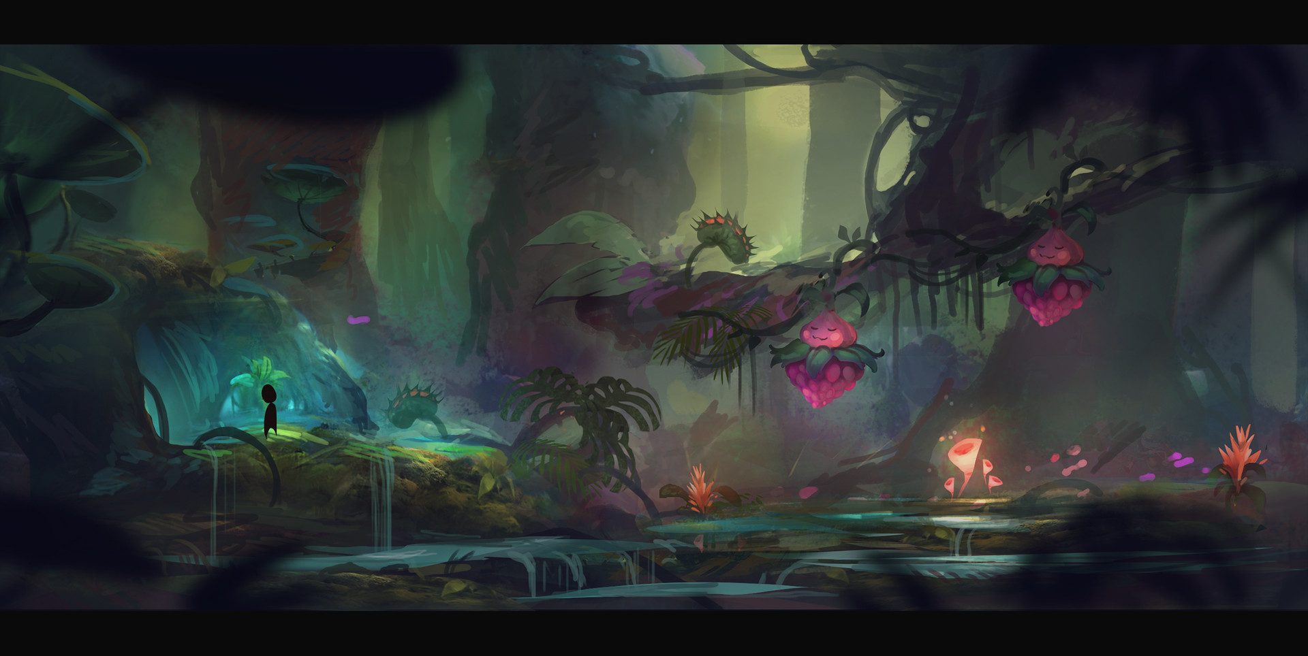
Overview
A single-player, scrolling platformer adventure game
Objective is to get main character to end of each level
Main character can only move and jump, but imaginary friend has special abilities based on world

Slide 3

Novel Aspect
Control two characters simultaneously, switch between them to overcome challenges
Swap between planes on the Z-axis to go explore a 3D world in 2D
Gain different abilities based on world, overcome enemies and challenges to complete each level

Slide 4

Dramatic Aspect
Character is a boy that falls into a magical world
Must navigate stages with the help of an imaginary friend
Plot is about conquering fears and a coming-of-age story

Slide 5




Technical Specs
Sprite-based, animated images overlaid on 3D objects in orthographic view in Unity
Art assets will be repurposed sprites and free library background images
Ultimate goal will be multiple worlds, each with a unique feature

Slide 6

Schedule
Functional minimum: One level, demonstrating character swap and combat mechanics
Low target: Two different levels, demonstrates special ability mechanics
Desired target: Two full worlds with unique world feature

Slide 7

Final Product
Four worlds: Last stage consists of final confrontation with imaginary friend. Combines all mechanics from previous worlds.
Extras:
3D models and textures
Sounds and music
More enemy variety
Additional worlds with unique mechanics

Slide 8
Image Credits
https://i.pinimg.com/originals/e0/58/c3/e058c3fc45183255beab30f06161ddb4.jpg
https://lh3.ggpht.com/Vu1HV8207XYiEGGKfu4uDpwFknw0VnKGKDPQH8ButriCW9zORuF5Gjk3WKxTgxB-btrC=h900
https://img.itch.zone/aW1hZ2UvMTM5MTQzLzYzNjc1Ny5qcGc=/original/AGPiE1.jpg
http://www.wallpaperup.com/uploads/wallpapers/2015/01/11/582618/bd3e7e3cf768af1dff60103344cd7b55.jpg
https://img.itch.zone/aW1hZ2UvMTM5MTQ2LzYzNjc2OS5qcGc=/original/d2BUA2.jpg
http://www.gameart2d.com/uploads/3/0/9/1/30917885/2507426_orig.jpg
http://blogs.discovermagazine.com/crux/files/2016/09/shutterstock_271332740.jpg
https://lh3.ggpht.com/DMs2Valfj-NIcl2CYIZLClPlAjnR4c9WcDJT59rQqTs79e8ZklfC91QhsreUpgYeDA=h900

